Slide 1



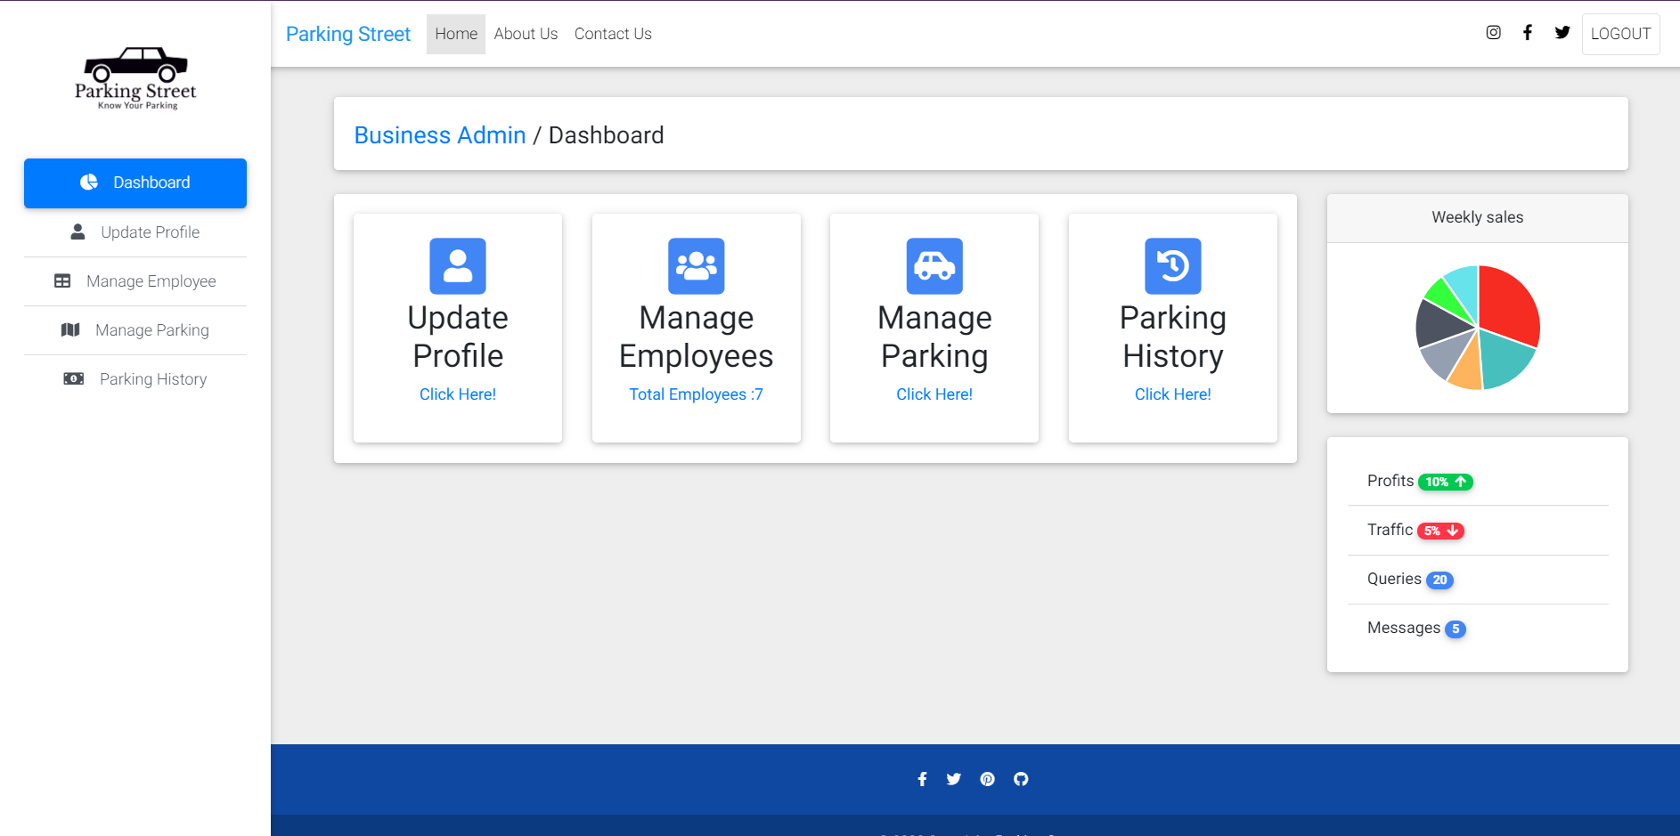
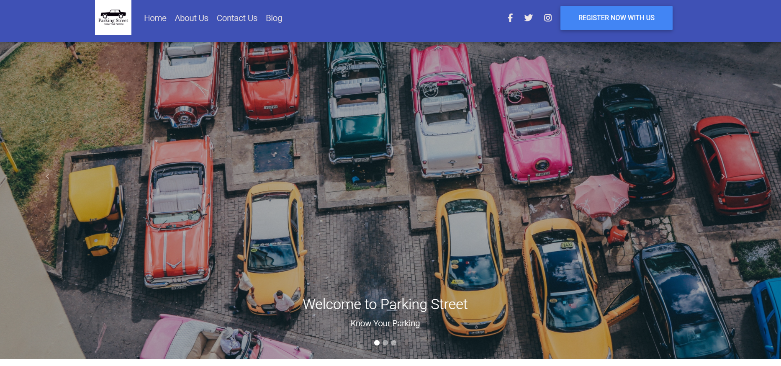
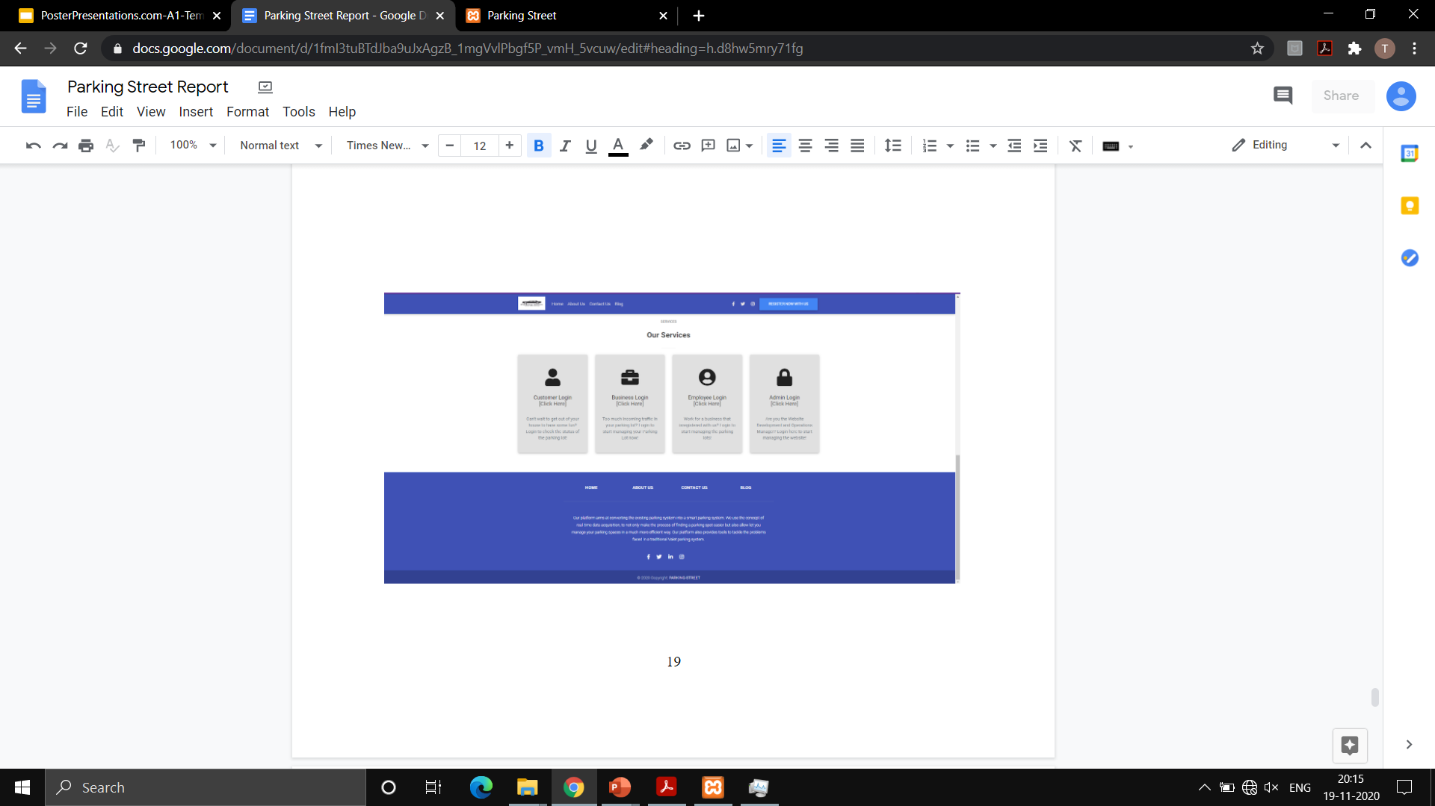
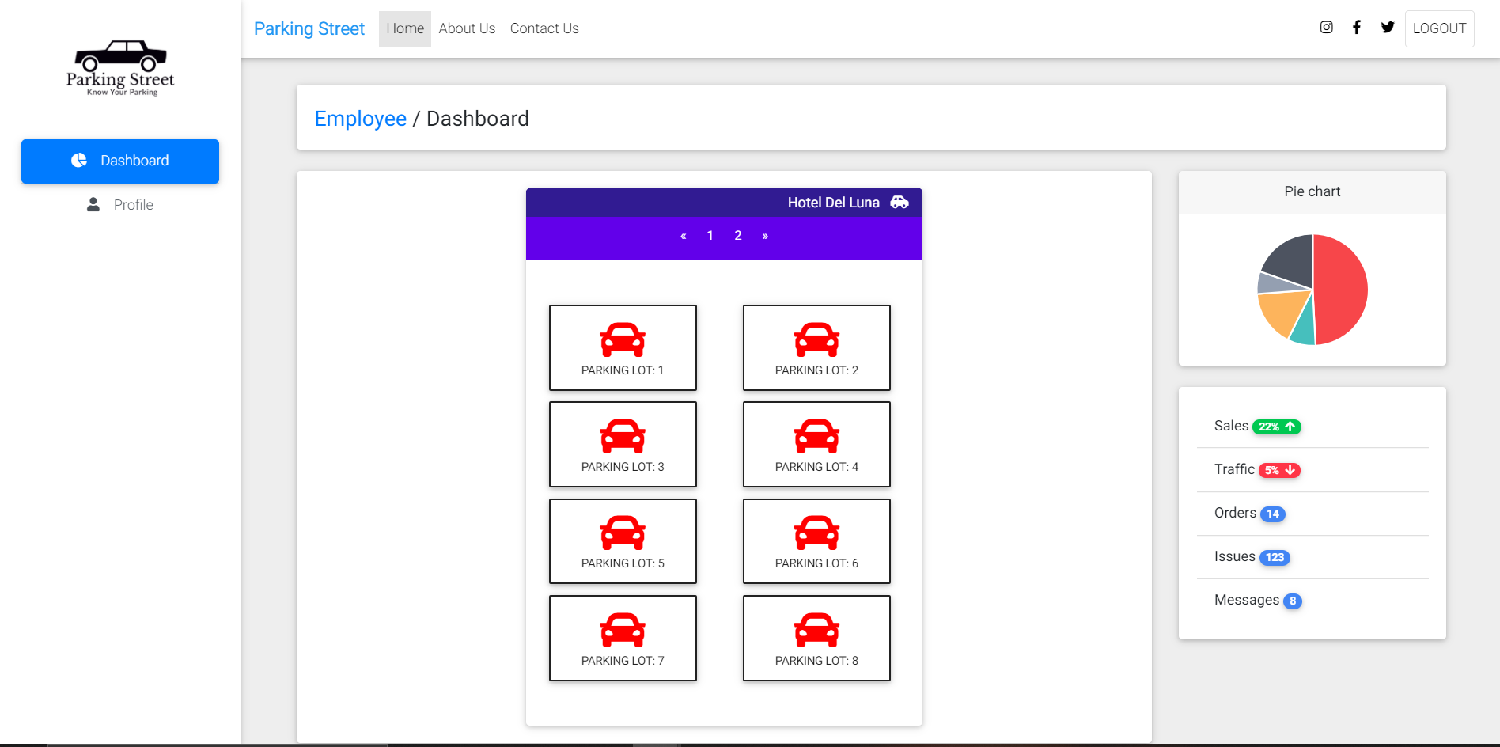



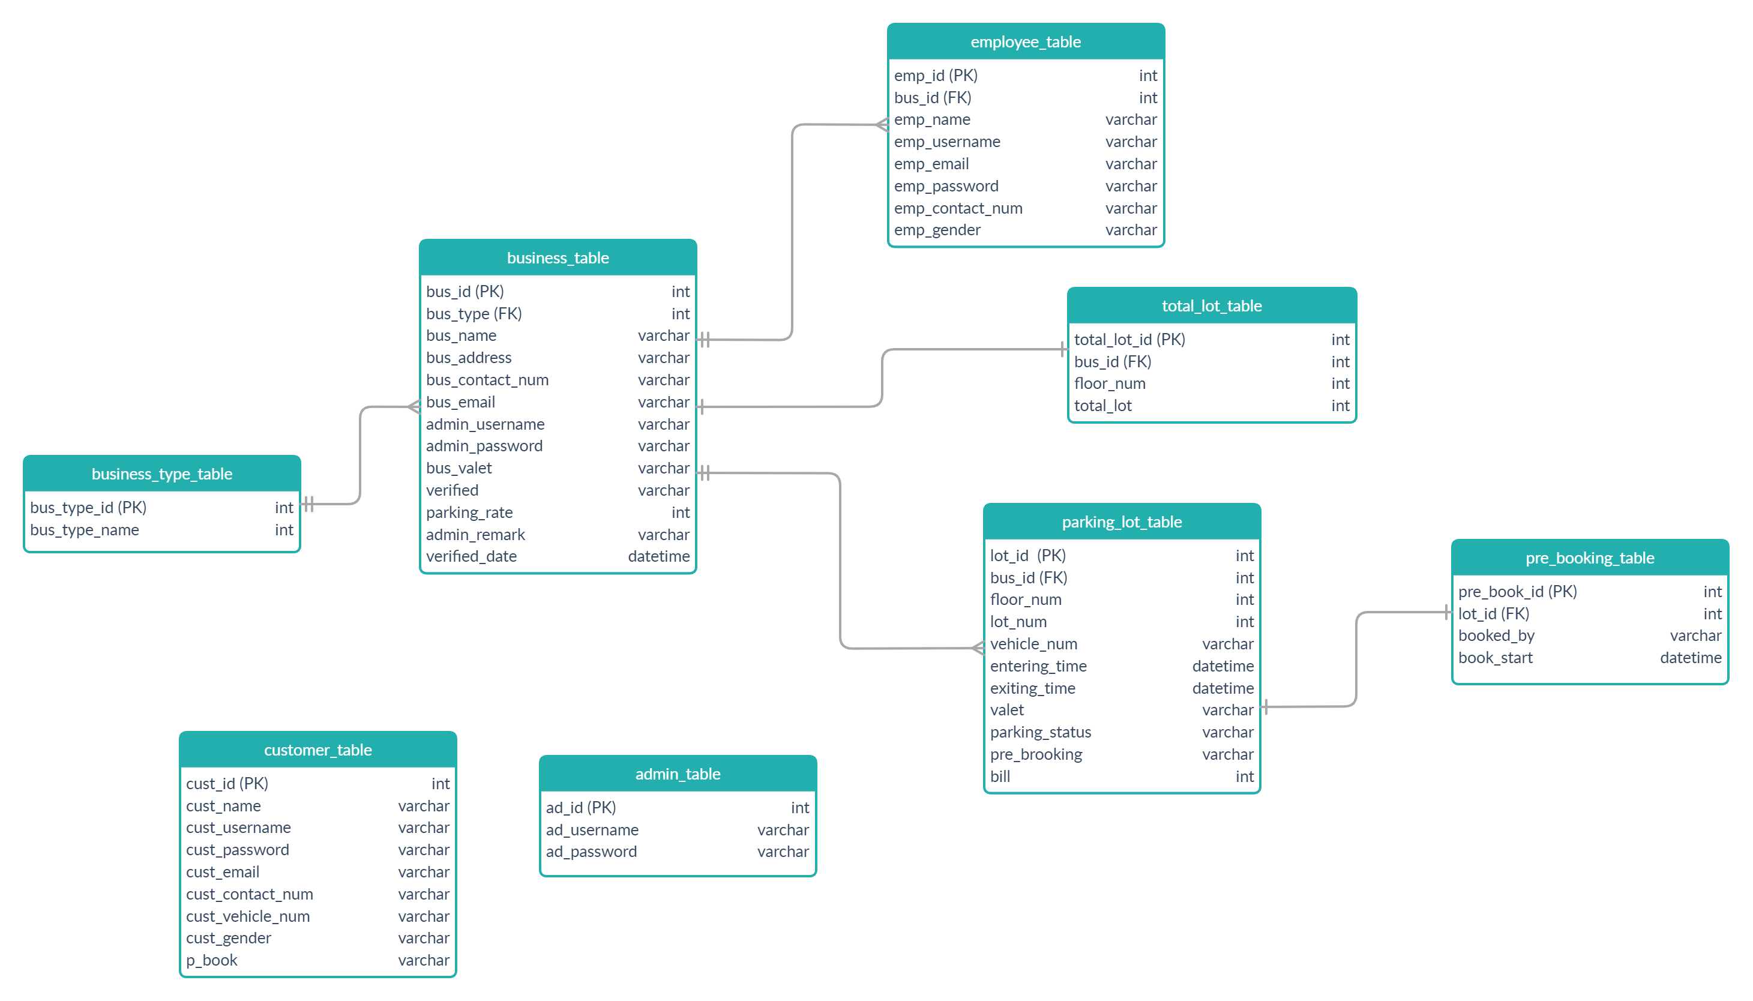



Parking Street : Know Your Parking
Second Year Project Poster, Fall 2020, Bennett University, Greater Noida, India
Members : Tarussi Shailendra Singh (E19CSE278), Shourya Mupparapu (E19CSE150), Swapnil Agrawal (E19CSE278)
Dept. of Computer Science Engineering, Bennett University, India
Introduction
Parking is an emerging problem. The search for a parking space is becoming more and more frustrating for people. Factors like lack of sufficient parking space and a constant increase in the number of vehicles only add to the difficulties
User Interface Snapshots
Problem Statement
In the traditional parking system, we have to perform some highly focused maneuvers in order to park our vehicles. Whether it is the searching for a spot with the continuous honking behind us or the hassle of moving to a whole new location just to park the vehicle.
Milestones Achieved
We started with scratch And we try to build the user-friendly UI for the potential customers to have clear views in their mind regarding their needs
Our Database team worked on what the information are being taken from the user and has to stored correctly on the database server
Get the final layout of the parking space that the customer needs to book so that it can be shown correct data to the employee of the hotel so that he/she can arrange it correctly.
The final stage deals with the through testing of the project to get the final analytics that we can store to get parking data of the vehicles.
Proposed System
This project aims at converting the existing parking system into a smart parking system.
By using the concept of real-time data acquisition, we hope to put forward a platform which would not only make it easier for the public to find a parking spot but will also allow hotels, malls, restaurants and other localities with parking spaces to manage their incoming traffic in a much more efficient way.
Techniques Utilized
Data Architecture Diagram

